Slide 1
A Comparison of Crowd Simulation Techniques
Author: Matthew Funcke
Supervisor: George Wells
Notes:
Breakdown:
1. Intro - reminder us what you are doing and why - quick summary of first few slides from first talk. 2. Give us some meat about the project - design, some implementation etc. 3. Discuss any problems that required changes to be made to the original plan. 4. Give any tentative results that have been found - if any 5. Discuss what still needs to be done 6. Conclude

Slide 2
Why compare them?
Many, many, models.
All different
Multiple Applications.
Entertainment Industry – Movies and Games
Evacuation simulation
Architectural optimisation
Crowd Control
Training – Military and Police
Teaching – Academic
Save time and effort in the future.
Notes:
There are many methods available to simulate crowds of people, I’ll elaborate on some of then in the next slide. Each method has its own advantages and disadvantages: for example some techniques are really cheap, while others cost an arm and a leg. The more expensive ones obtain more accurate and reliable results, while the cheaper options give only a vague representation of how a crowd mgiht behave. In some situations one might be more appropriate than the other.
The reason I want to compare the major crowd simulation techniques is 2 fold: I want to find out when each method of crowd simulation is appropriate, hopefully saving people time and effort in the future. The second reason is that there are just so many benefits, in so many fields, to be gained from appropriate use of crowd simulation.
For Example
Pedestrian simulation
Airlines have used swarm theory to simulate passengers boarding a plane. Southwest Airlines researcher Douglas A. Lawson used an ant-based computer simulation employing only six interaction rules to evaluate boarding times using various boarding methods.(Miller, 2010, xii-xviii).^{[30]}
-Save time, detect potential problems
Safety evaluation
Panicked crowds
Find dander zones
Determine if a venue is safe – concert, stadium, theater etc...
Architectural optimisation
Make pedestrian movement efficient,
Detect potential problems
Detection of bottlenecks
Entertainment Industry
It used to be extremely costly to use CGI to generate a crowd for movies (every single bone, in every single model had to be adjusted “by hand”), however once programs such as Massive where developed costs plummeted allowing people in the entertainment industry to more easily recreate their artistic vision, in HD no less.

Slide 3
Types of models
Three base methods
Cellular Automata
Rule-based Models
Social Forces Models
Hybrid models eg:
MassMotion
Massive
HiDAC
Notes:
Cellular Automata
Rule-based Models (Reynolds)
Social Forces Models (Dirk Helbing)
MassMotion – Oasys Software

Slide 4
An overabundance of models
Quinn SF
Floor Fields
MASCM
Massive
ALLSAFE
Muramatsu
SGEM
Exodus
HiDAC
ABS CA
Exit89
Burstedde
Space Syntax
OpenSteer
Aseri
Kebel et al.
Autonomous Pedestrians
Crosses
PathFinder
Blue & Adler
FPETool
Paxport
Reynold
F.A.S.T.
Kirchner
MassMotion
Legion
Reactive Navigation
Social Distances
PEDFLOW
Helios
Helbing SF
Maïm
Wagoum
Simwalk
Simulex
ACUMEN
TIMTEX
Notes:
Red have been researched
Need a representative sample of about 10 (possibly more)

Slide 5
A Representative Sample
2 of each fundamental model
2 low complexity/quality models
2 medium complexity/quality models
2 high complexity/quality models

Slide 6
The models to analyse
H
H
H
L
M
L
M
L
M
Massive
Massmotion
HiDAC
Helbing
Quinn
Reynolds
OpenSteer
Generic CA
ABS
Hybrid Models
Social Forces Models
Rule-based Models
Cellular Automata

Slide 7
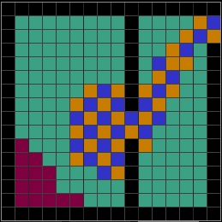
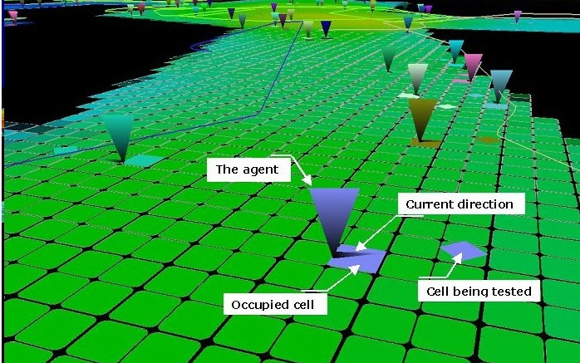
Cellular Automata
Generic Cellular Automaton
ABS Cellular Automaton

Slide 8
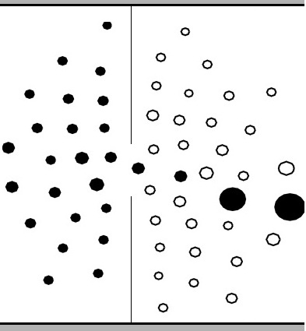
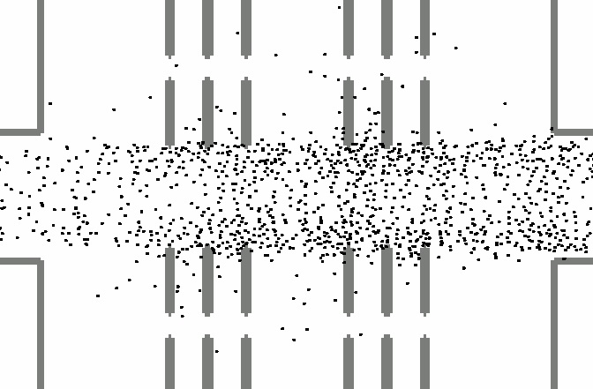
Social Forces Models
Original Social Forces
Parallelised Social Forces

Slide 9
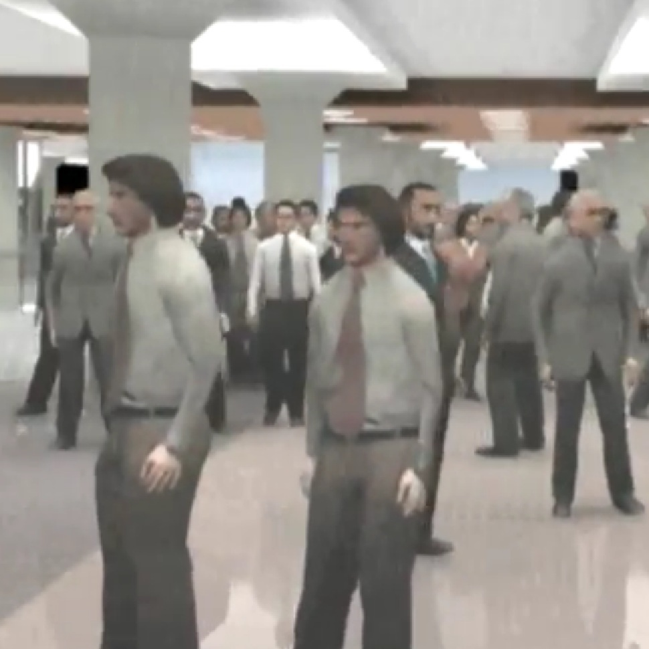
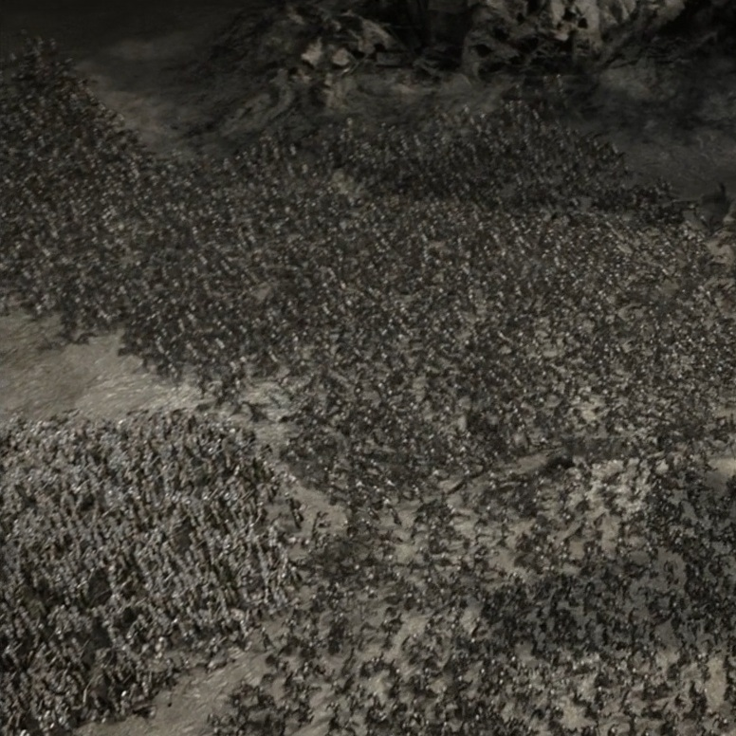
Hybrid Models
MassMotion
Massive Software

Slide 10
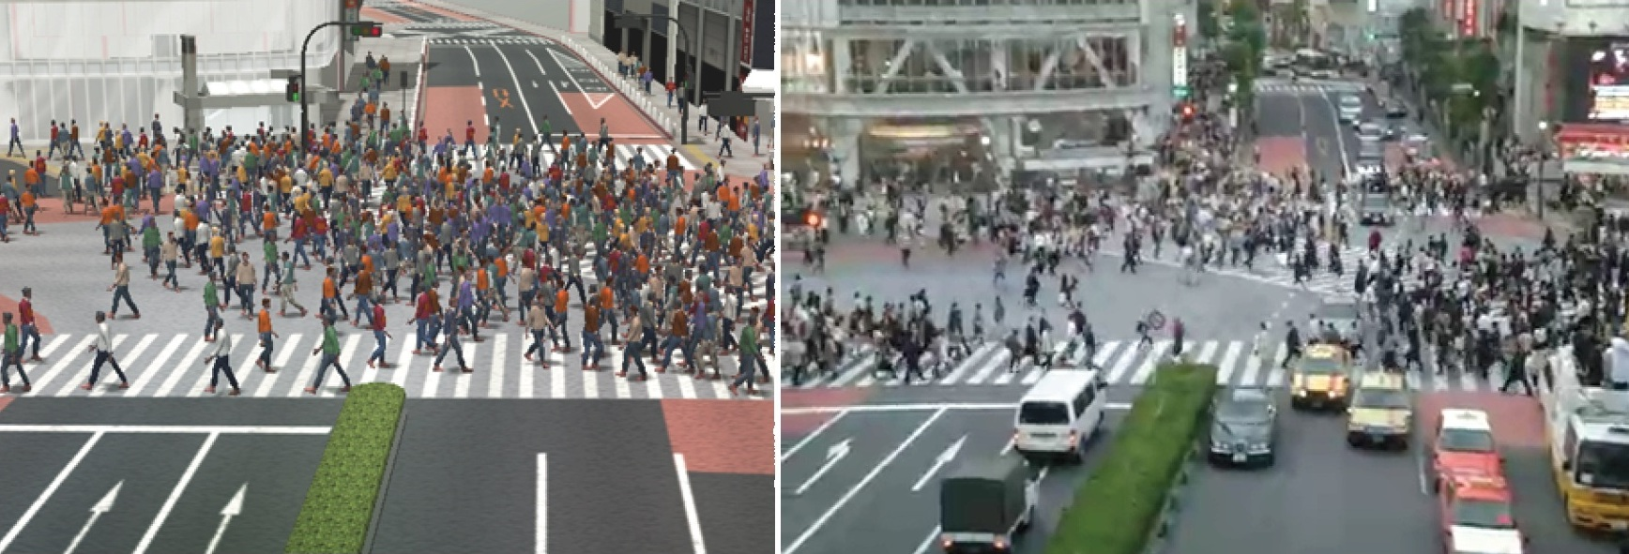
Comparing models
Several proposed methods:
Visual comparison

Slide 11
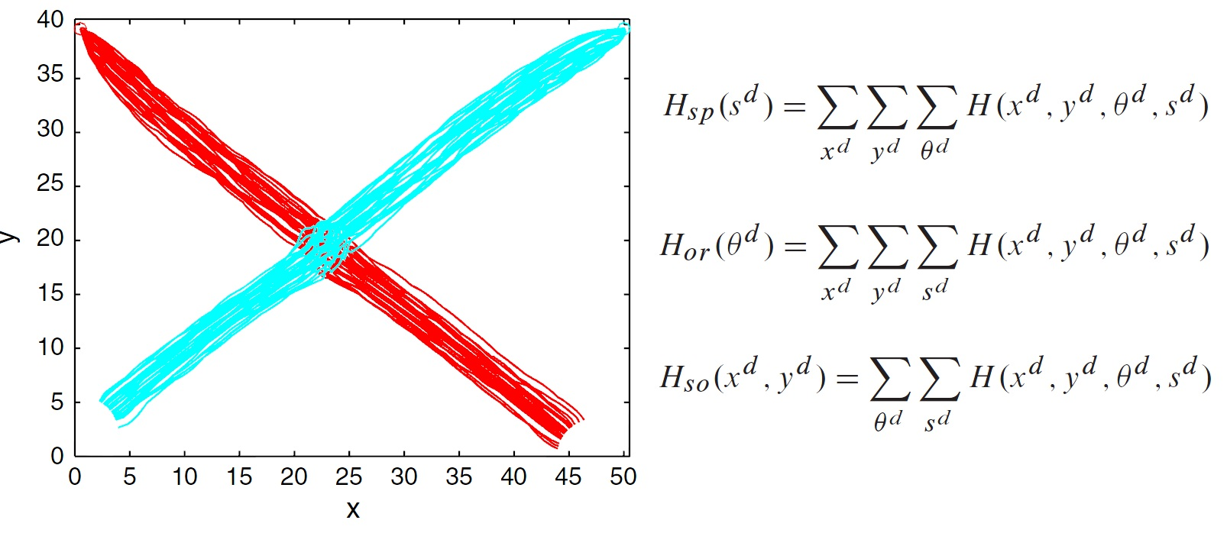
Comparing models
Several proposed methods:
Visual comparison
Quantitative 4D histograms

Slide 12
Comparing models
Several proposed methods:
Visual comparison
Quantitative 4D histograms
Literature-based scoring:
Identify common comparison factors
Weight application
Score models
Apply equations
Compare specific models based on final scores
Generalise results

Slide 13
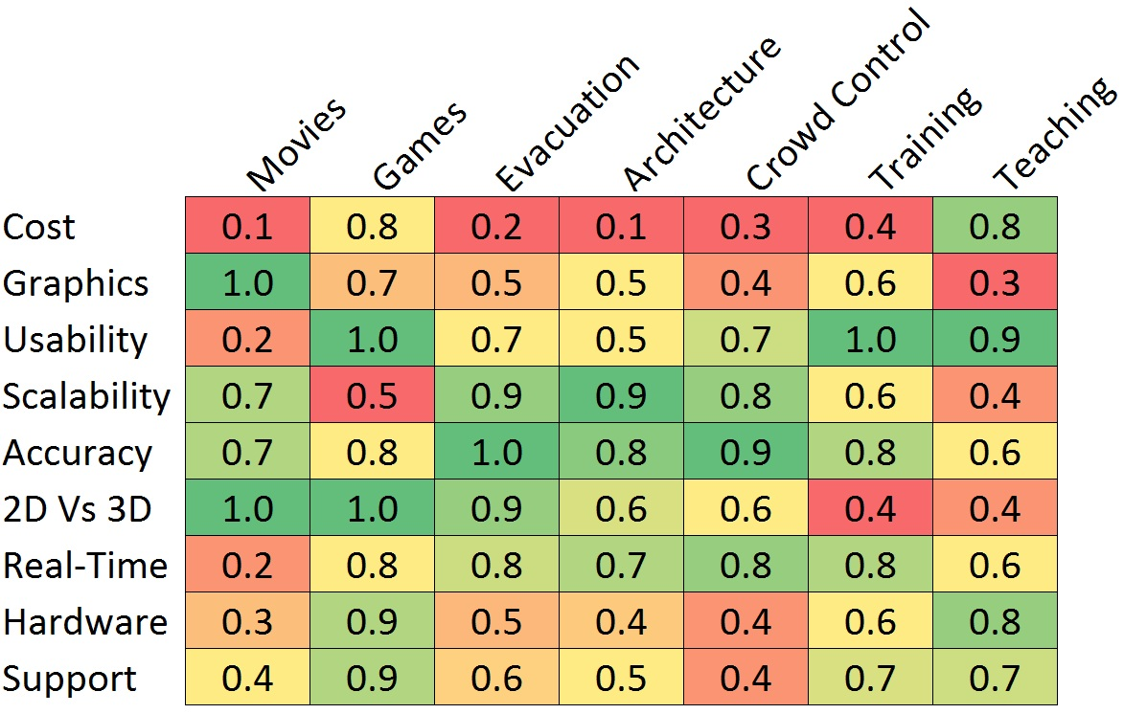
Comparing models - Weights

Slide 14
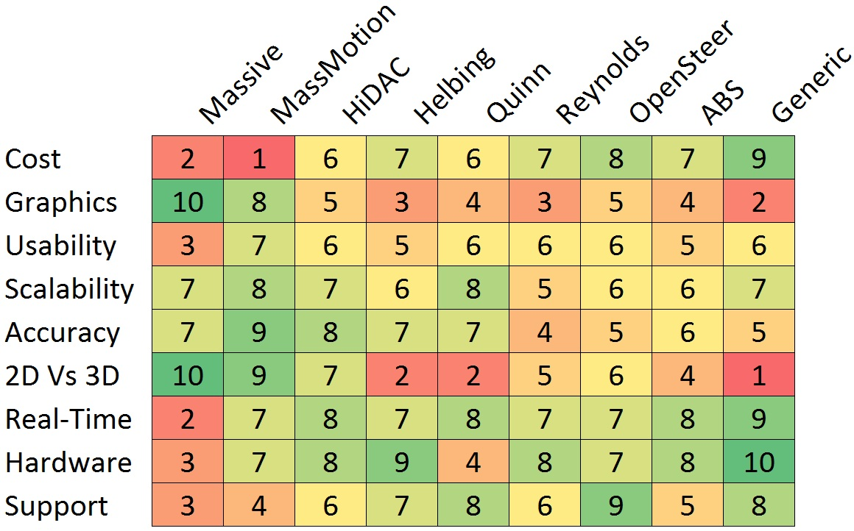
Comparing models - Scores

Slide 15
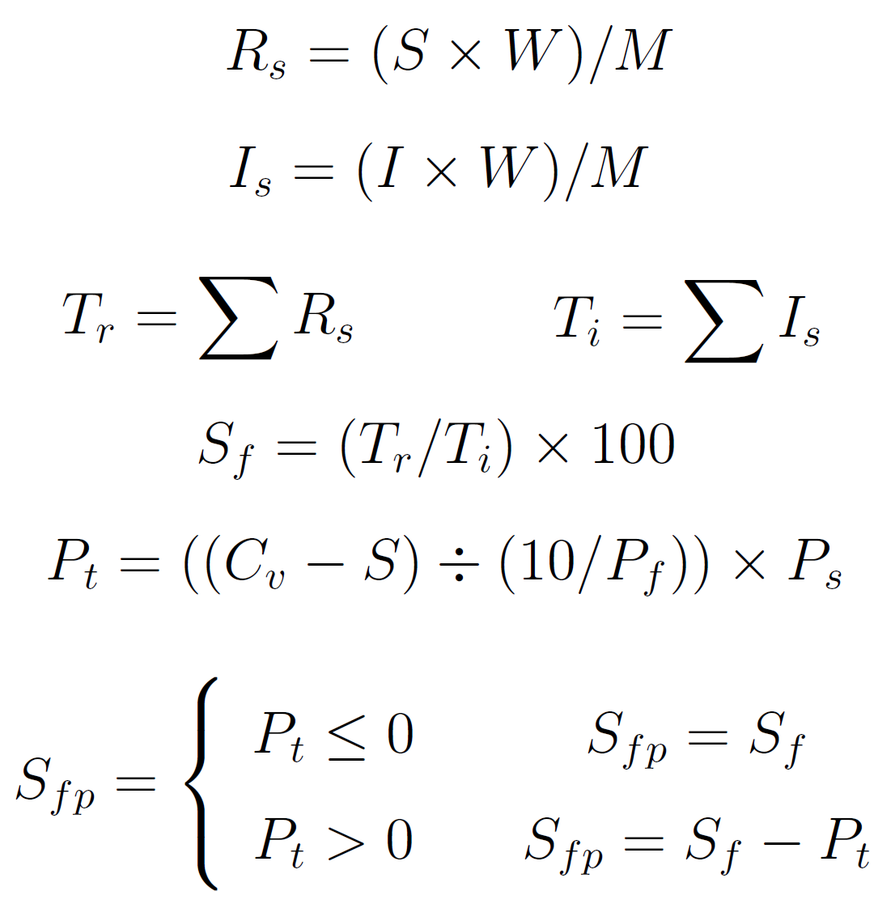
Comparing models – Equations
Weighted
Average

Slide 16
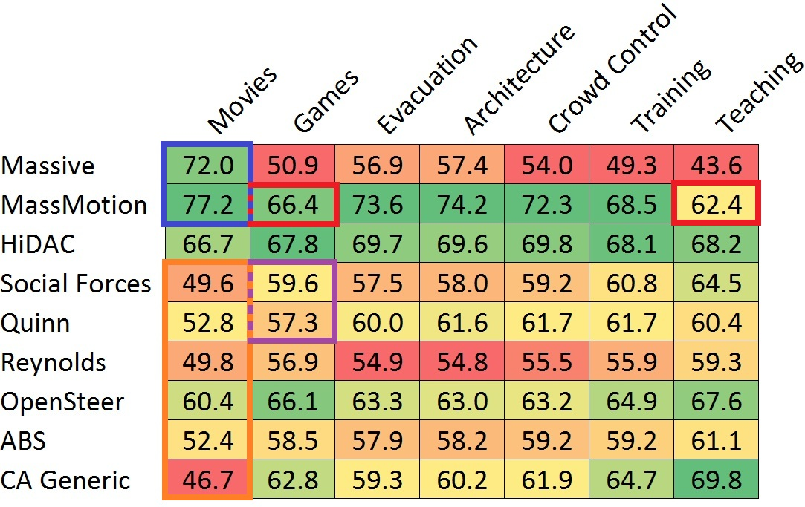
Results – before penalties
Notes:
Red – Huge cost
Purple – Hardware issues

Slide 17
Comparing models – Equations
Weighted
Average
Penalties

Slide 18
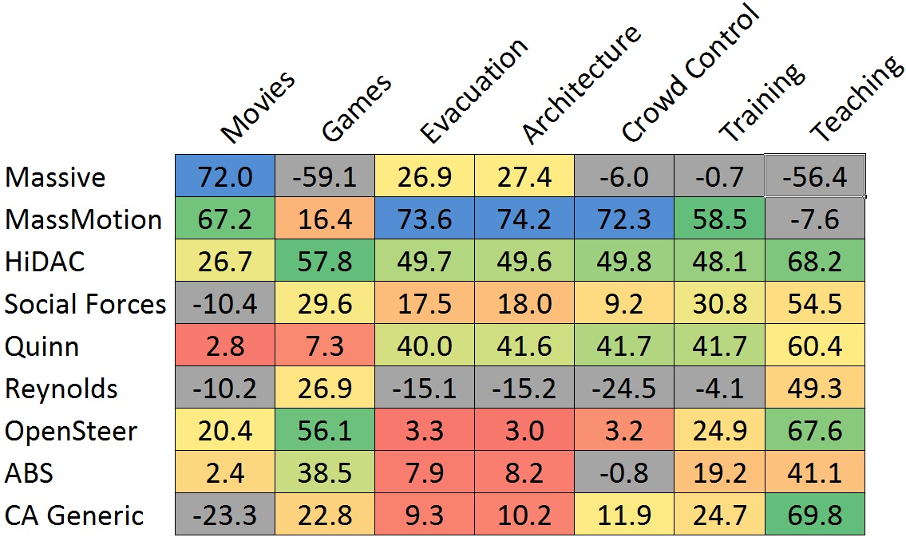
Results – after penalties

Slide 19
Specific Conclusions
Application | Best Model
Movies | Massive
Games | OpenSteer or HiDAC
Evacuation | MassMotion
Architecture | MassMotion
Crowd Control | MassMotion
Training | MassMotion
Teaching | Generic CA

Slide 20
Specific Conclusions
Application | Best Model
Movies | Massive
Games | OpenSteer or HiDAC
Evacuation | MassMotion
Architecture | MassMotion
Crowd Control | MassMotion
Training | MassMotion
Teaching | Generic CA
Bias?

Slide 21
Specific Conclusions: Non-commercial / Hybrid
Application | Best Model
Movies | OpenSteer
Games | OpenSteer
Evacuation | Quinn
Architecture | Quinn
Crowd Control | Quinn
Training | Quinn
Teaching | Generic CA
Anything ->

Slide 22
Generalised Conclusions
Commercial models are generally better.
Hybrid models are generally best.
Social forces if you need accuracy.
CAs when simplicity is essential.
Rule-based models for when looks and not accuracy matter.

Slide 23
?
Notes:
Cost
Scale
Accuracy
2D/3D only
Rendering quality
Ease of use
Movies – high everything, except Ease of use - Massive
Engineering –high everything, except rendering and Ease of use - MassMotion
Pedestrian planner – low everything except scale – cellular automaton or Social Forces Model

